Slide 1

Non Relational Databases
By Aeron Roemer

Slide 2

Relational Databases
Relational databases, like we’ve been using, began in the 1970’s. Data is organized into columns and rows, and stored in tables. They generally use SQL.

Slide 3
Why Use a Relational DB?
Queries
Ease of Use
Reduce Redundancy
Ability to make complex queries (especially using JOIN)
Easy to update, delete and make other chages while the database is up and running.
It may integrate well with your tech stack.
Plus, SQL is commonly known.
Often the most efficient way for storing structured data

Slide 4
Non Relational Databases
Although they have existed since the 1960’s Non-Relational Databases have recently become more popular (21st century). No tables, rows, primary keys, etc. Data format changes based on the demands places on it.

Slide 5
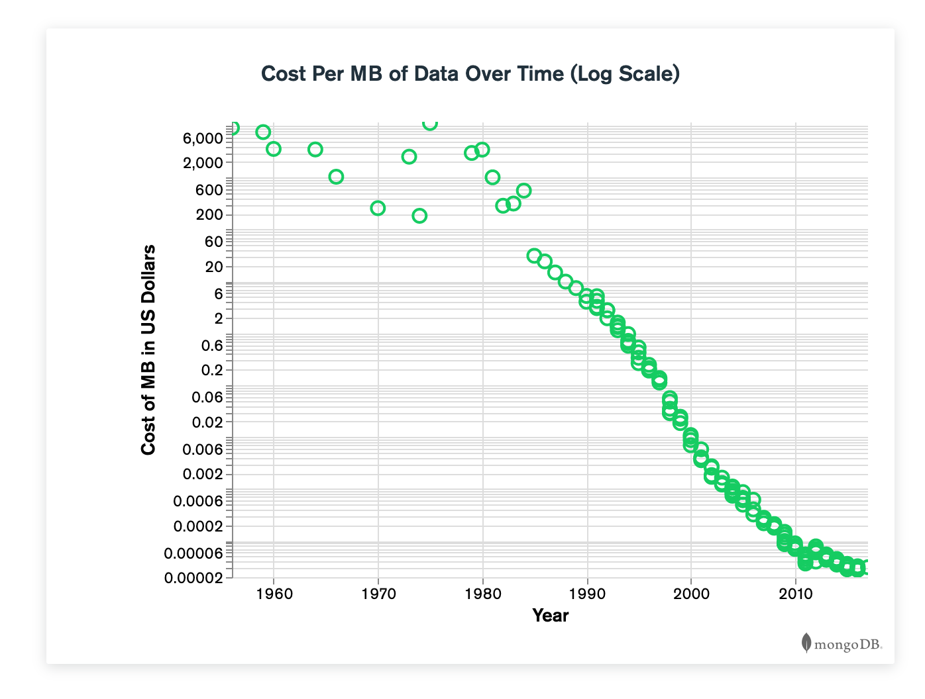
As data storage costs went down, the need to optimize storage also decreased. Developers salaries began to cost companies more than storage, so it made sense to design databases around the needs of developers.AGILE development practices and the rise of cloud computing also created more demand for a flexible, distributed way of managing data.

Slide 6
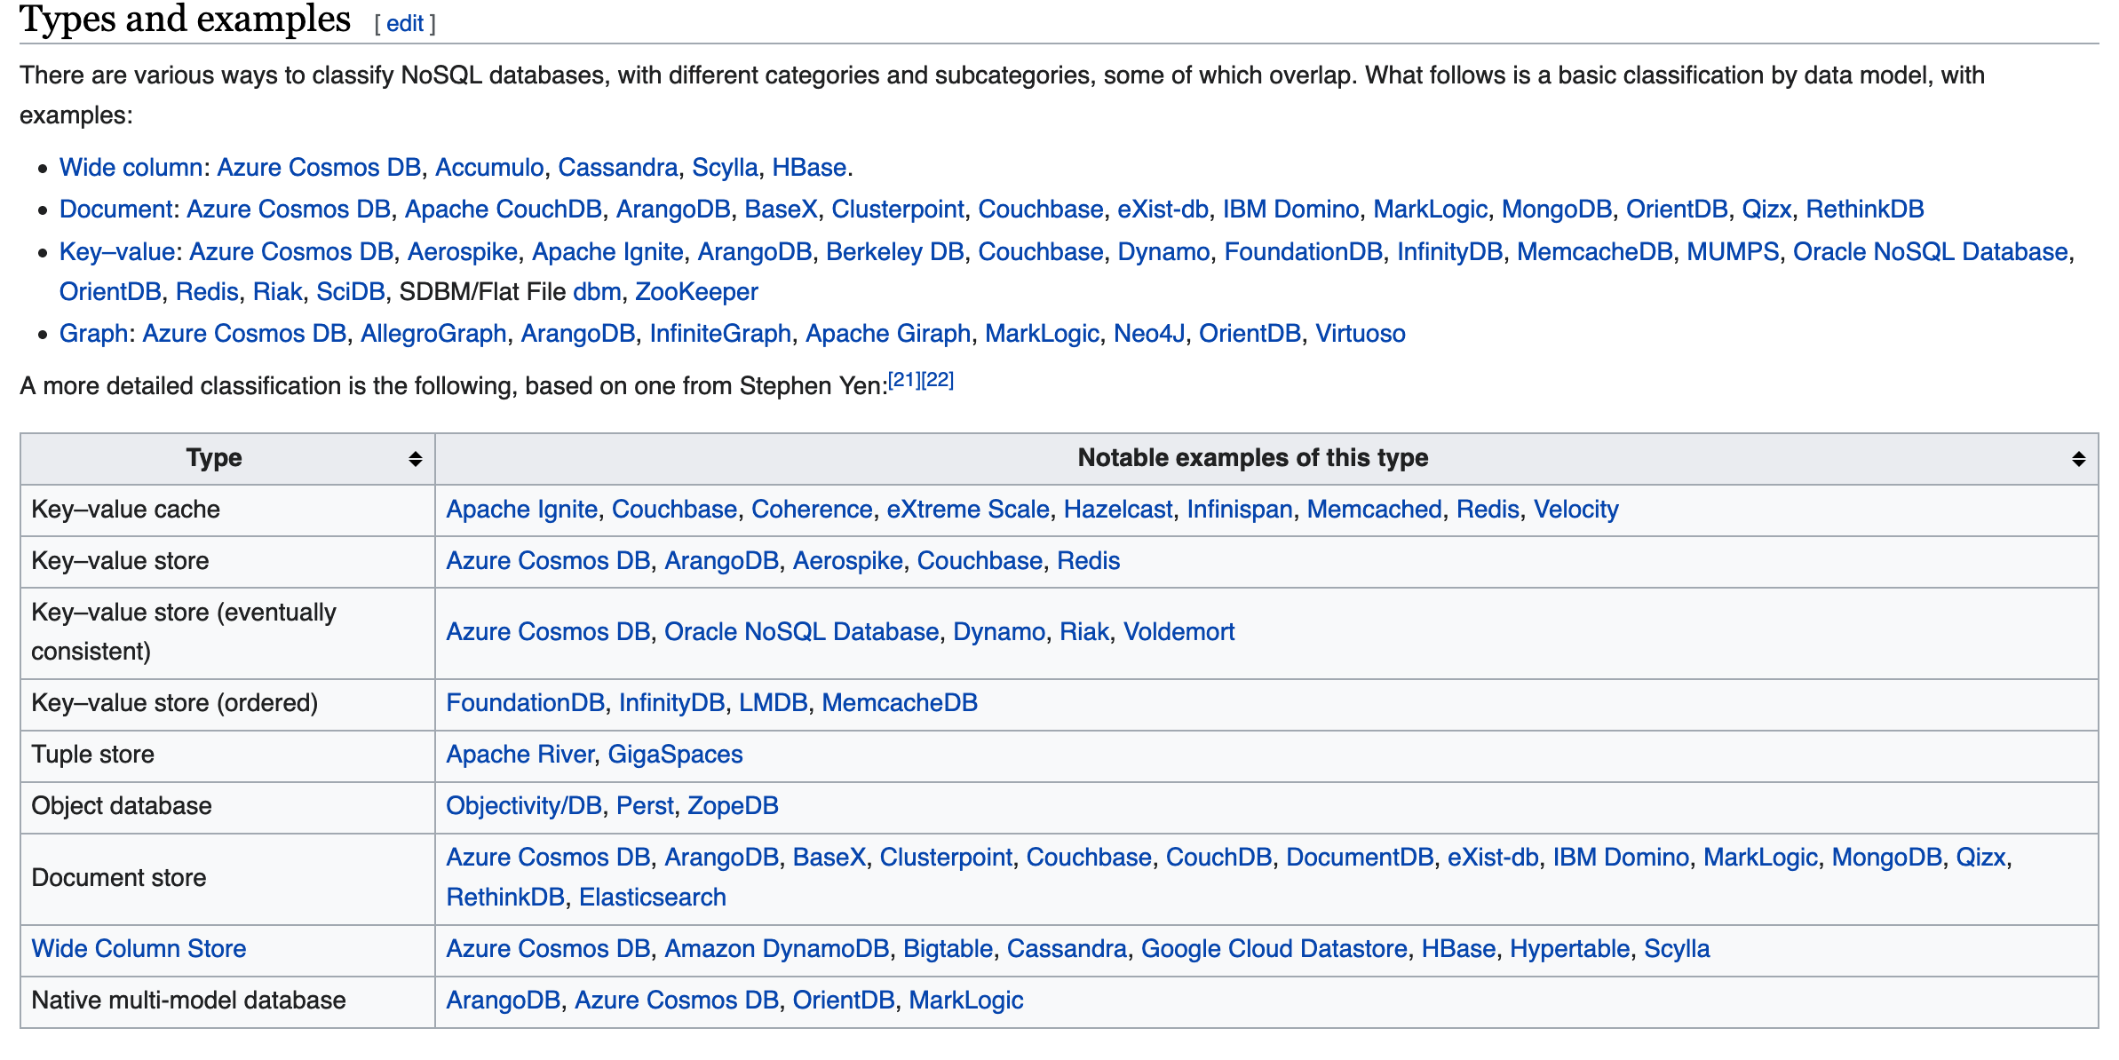
Examples
There are a lot of different ways of organizing data in ‘Not Only SQL’ Databases.

Slide 7
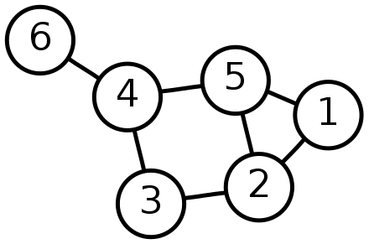
Some Examples
Key-Value Store
Only uses Keys and Values. For example, you might want to store your community email list this way.
Graph
For data where each node has a finite number of links. Such as public roadways or transit system data.

Slide 8
Some Examples
Wide-Column Store
It uses tables, rows, and columns, but the names and format of the columns can vary by row in the same table. Ex: google Bigtable which stored data for Google Maps, ‘My Search History’ etc
Document Oriented
A subtype of the Key value store, here data is stored in a format like XML or JSON. A common example is MongoDB.

Slide 9
Why Use a Non Relational DB?
Flexible Data Model
Scalability
Many Nodes
Data can be stored in many more ways.
Desgined with growth in mind, they can be faster when dealing with massive amounts of data.
Often work well ‘in the cloud’ – on servers around the world, automatically synchronizing.

Slide 10
Example Document
{
"Name": "Joe Boguso",
"Email": "hooligan@jboguso.com",
"Occupation": "Retirement Financial Advisor",
“Family”: [“Alfred Sr.”, “Alfred”, “Alfred Jr.”]
}

Slide 11
Example Queries
MongoDB
db.person.find({name: “Joe”})
Cassandra (Open Source)
SELECT name FROM restaurants WHERE cuisine='Fish and chips';
Dynamo DB (Amazon)
GUI with search fields

Slide 12
Unstructured Data
With more data being created and gathered than ever before, having ways to store and access this information is important. Data lakes and data warehouses can also be used to store these massive amounts of data.
Some estimates say 90% of datasets used by ‘big data’ are unstructured:
https://www.pcmag.com/news/90-percent-of-the-big-data-we-generate-is-an-unstructured-mess

Slide 13
Instructions for use
In order to use this template, you must credit Slidesgo by keeping the Thanks slide.
You are allowed to:
- Modify this template.
- Use it for both personal and commercial projects.
You are not allowed to:
- Sublicense, sell or rent any of Slidesgo Content (or a modified version of Slidesgo Content).
- Distribute Slidesgo Content unless it has been expressly authorized by Slidesgo.
- Include Slidesgo Content in an online or offline database or file.
- Offer Slidesgo templates (or modified versions of Slidesgo templates) for download.
- Acquire the copyright of Slidesgo Content.
For more information about editing slides, please read our FAQs or visit Slidesgo School:
https://slidesgo.com/faqs and https://slidesgo.com/slidesgo-school

Slide 14
Fonts & colors used
This presentation has been made using the following fonts:
Fjalla One
(https://fonts.google.com/specimen/Fjalla+One)
Barlow Condensed
(https://fonts.google.com/specimen/Barlow+Condensed)
#494949
#477797
#77c6fc
#bbe3fe
#ddf1fe

Slide 15

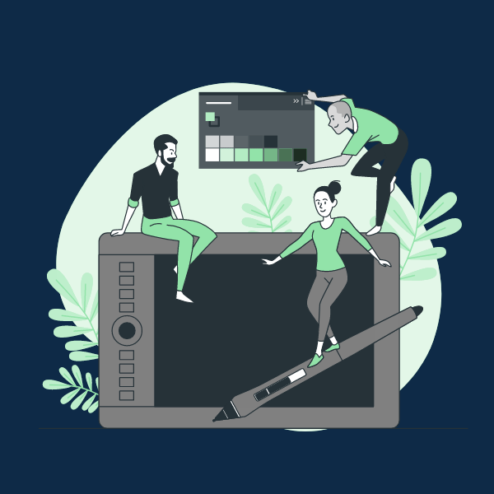


Stories by Freepik
Create your Story with our illustrated concepts. Choose the style you like the most, edit its colors, pick the background and layers you want to be visible and bring them to life with the animator panel. It will boost your presentation for sure! Check out how it works.
Pana
Amico
Bro
Rafiki

Slide 16
Use our editable graphic resources...
You can easily resize these resources without losing quality. To change the color, just ungroup the resource and click on the object you want to change. Then, click on the paint bucket and select the color you want. Group the resource again when you’re done. You can also look for more infographics on Slidesgo.

Slide 19
JANUARY
FEBRUARY
MARCH
APRIL
MAY
JUNE
PHASE 1
Task 1
Task 2
PHASE 2
Task 1
Task 2
JANUARY
FEBRUARY
MARCH
APRIL
PHASE 1
Task 1
Task 2

Slide 22
...and our sets of editable icons
You can resize these icons without losing quality.
You can change the stroke and fill color; just select the icon and click on the paint bucket/pen.
In Google Slides, you can also use Flaticon’s extension, allowing you to customize and add even more icons.

Slide 23
Educational Icons
Medical Icons

Slide 24
Business Icons
Teamwork Icons

Slide 25
Help & Support Icons
Avatar Icons

Slide 26
Creative Process Icons
Performing Arts Icons

Slide 27
Nature Icons

Slide 28
SEO & Marketing Icons

Slide 29


